Slide 1
Dual-Arm Robotic Automation of Metal Tube Surface Processing

Slide 2
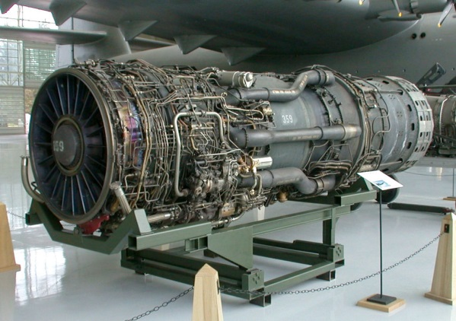
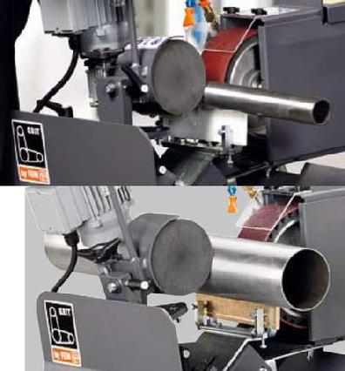
Motivation
Wide application area of tubular parts
Kitchen Appliances
Aviation Products
Industrial Application
Limited Existing Automation Technics
Greater Improvement Room
Source : http://en.wikipedia.org/wiki/Pratt_&_Whitney_J58
http://www.industrysaw.com/gritbyfein/centerlessgrinding.html

Slide 3

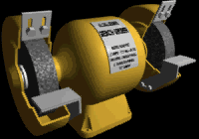
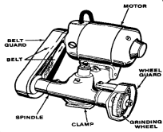
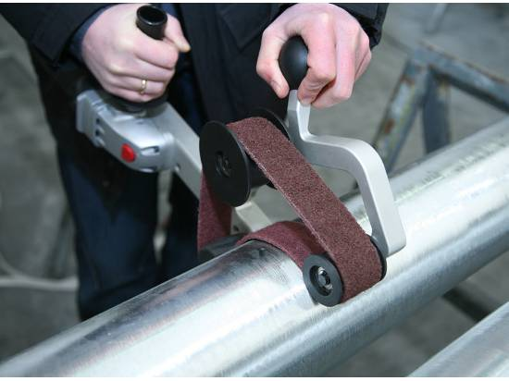
Background
Image Sources :
http://en.wikipedia.org/wiki/Grinding_machine
http://www.smithy.com/machining-handbook/chapter-8/page/3

Slide 4
Challenges
Numerous Tubular Configurations and Sizes
Necessary Dexterous Manipulation
Flexible and General Solution

Slide 5
Contributions
Conceptualized system that perceives tubular object, identifies optimized grasp locations and manipulates object using dual arms for machining.
Presented model approximation technic using 3D Point Cloud data processing.
Presented method to identify optimized grasps for given trajectory of an object
Validated proposed system concept in simulation environment

Slide 6
Approach
Dual Arm Manipulator
3D Sensing
Platform
PR2
Kinect for RGBD sensing
Two 7 DOF Arms
Supported ROS Platform
System Validation Using Simulation
C++

Slide 7
Outline
Perception
Point Cloud processing
Model Approximation
Grasps
Grasp Generation
Grasp Analysis and Trajectory Validation
Manipulation Matric
System Layout
Process Flow
Simulation
Future Work

Slide 8
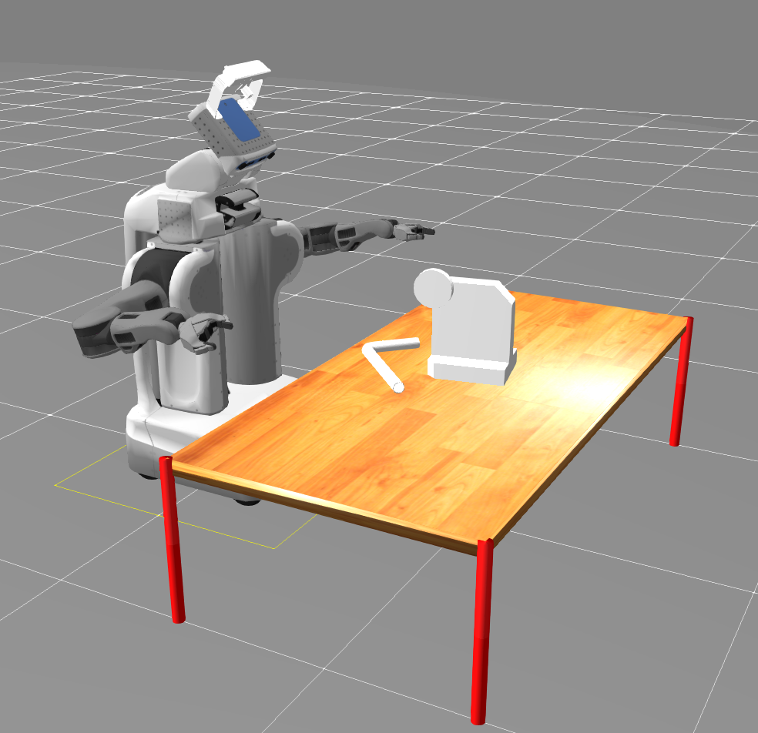
Workspace setup
Image (Table + PR2 + MC + workpiece)
Kinect Sensor
Machine Tool
Workpiece

Slide 9
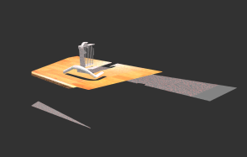
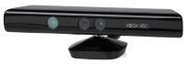
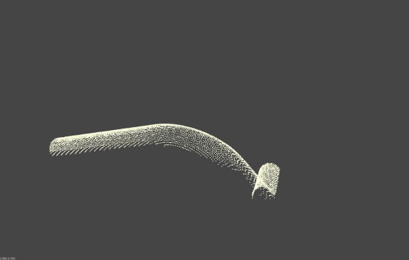
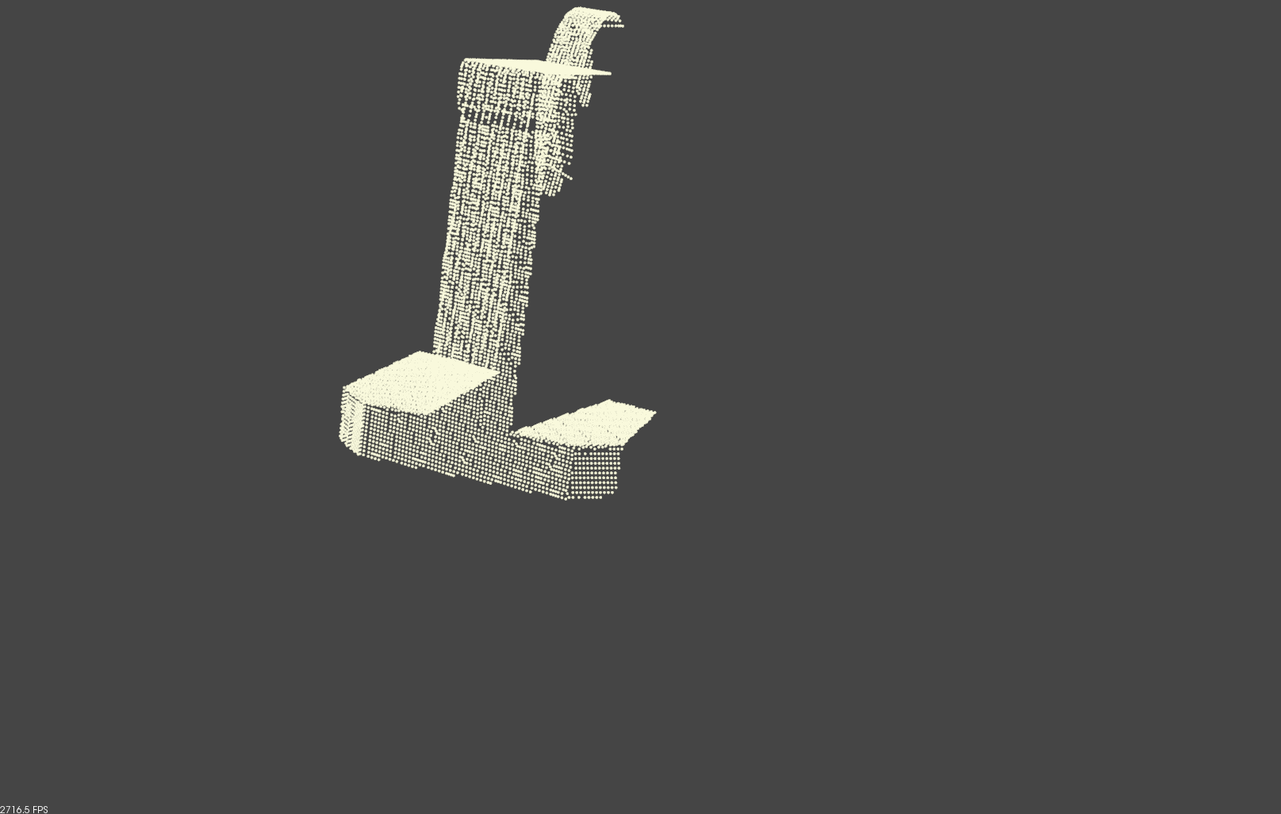
Perception
Point cloud pre-processing
Scene
Environment
RGBD Sensing
Segmentation
(tabletop segmentation srv)
Table Model
(Pose and Dimensions)
Machine Tool

Slide 10
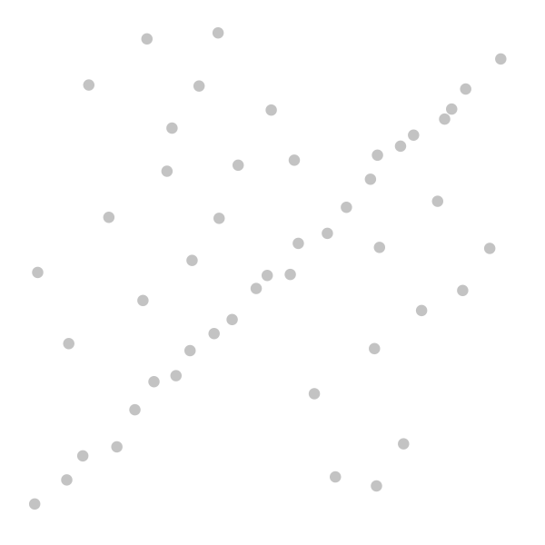
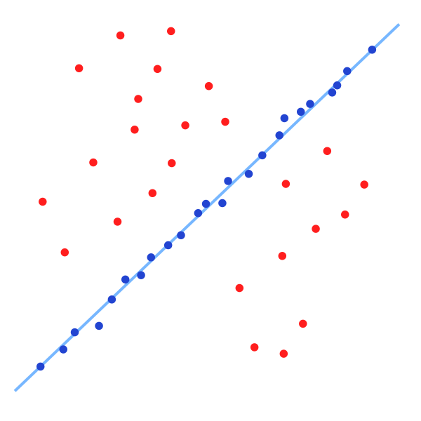
Perception
RANSAC
Select a random subset of observed data as hypothetical inliers
Model fitting on these inliers
Test all points of data set, if fits consider part of consensus set
Re-estimate with consensus set to optimize model parameters
Source: en.wikipedia.org/wiki/RANSAC
Source: en.wikipedia.org/wiki/RANSAC

Slide 11

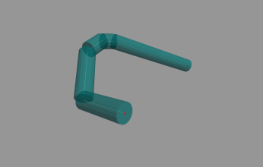
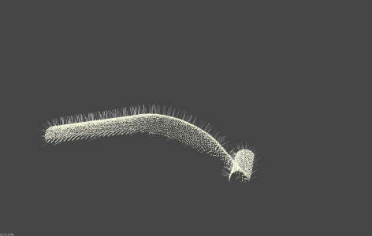
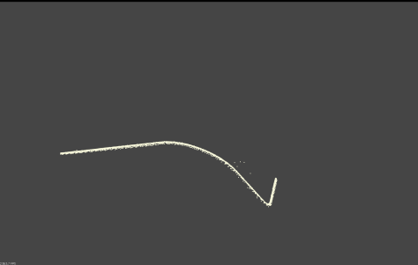
Perception
Tube Model Approximation
Point Cloud
Processing
Segmented
Point Cloud Cluster
Approximated
Tube Model
Radius
Cylinder RANSAC

Slide 12

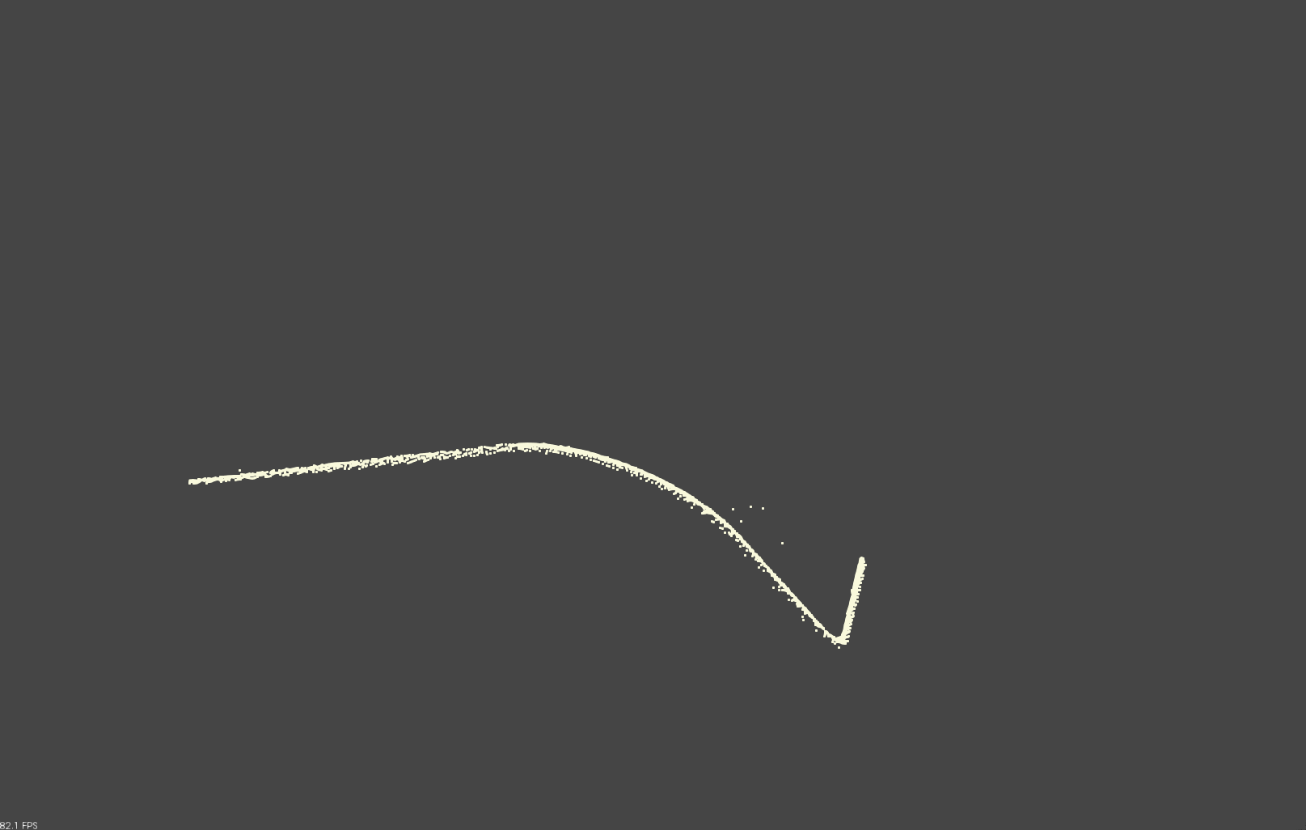
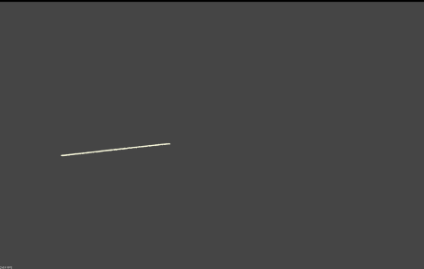
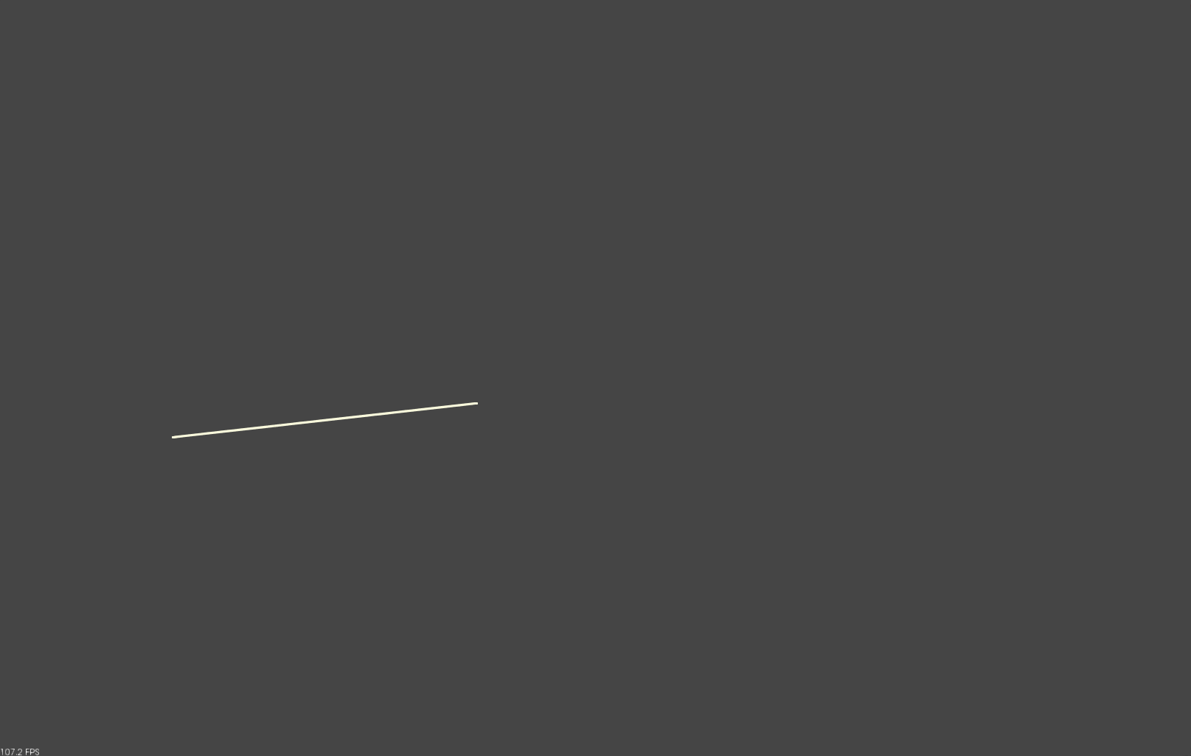
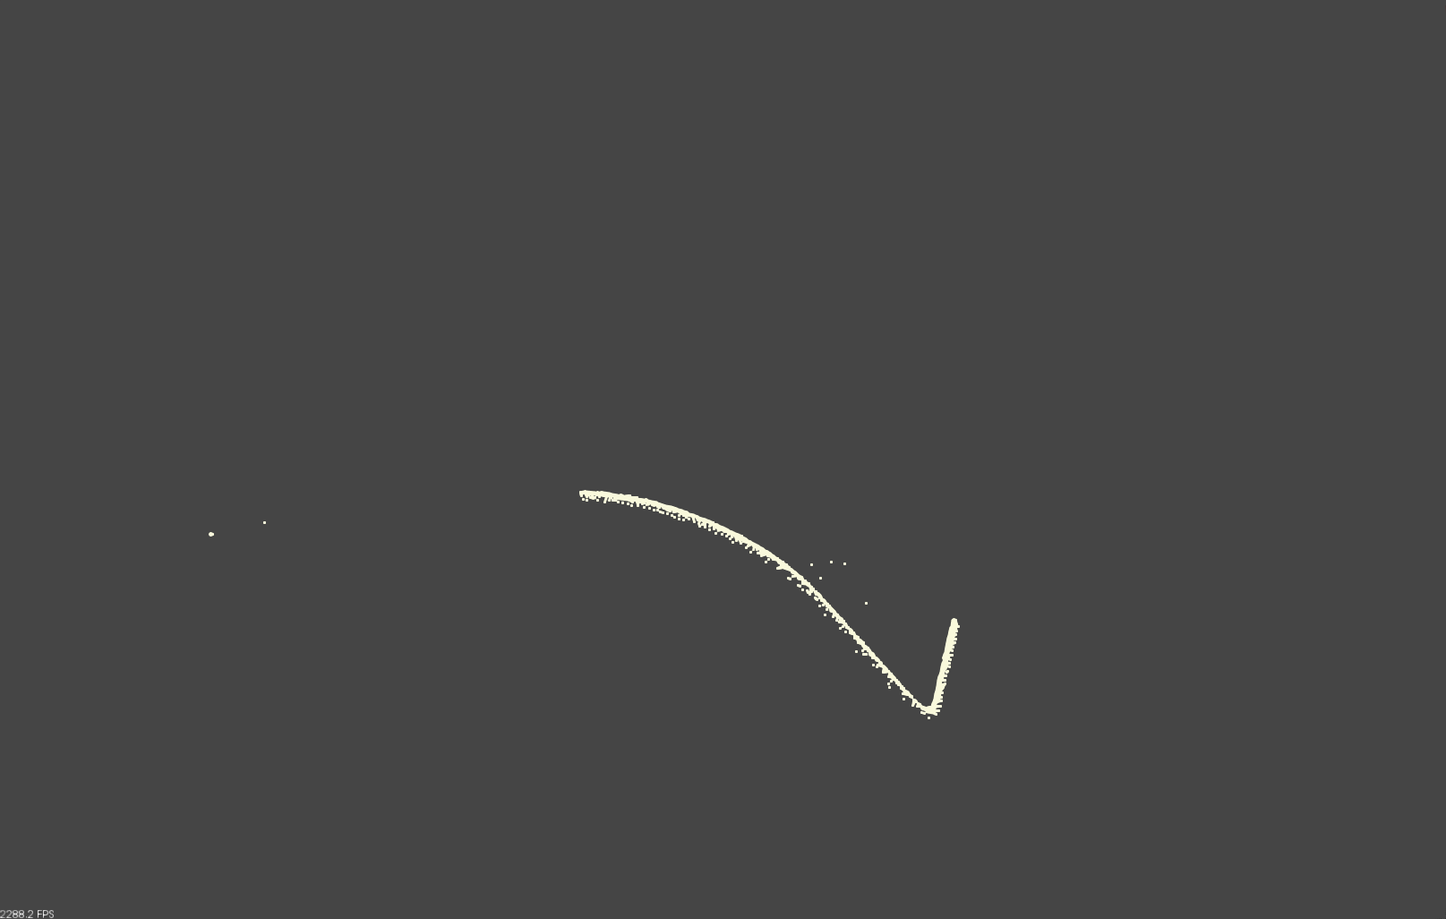
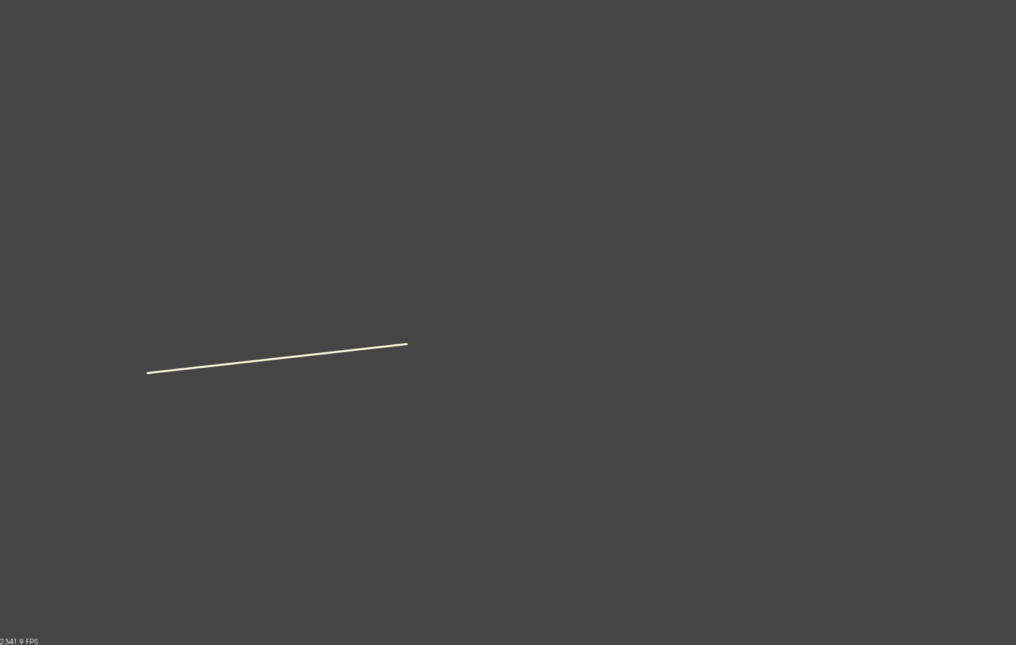
Perception
Line RANSAC
Next Iteration
Minus Inliers
Line Model,
Inliers
Projected Inliers
Filter points in cylinder
Extract and Store
End Points
Radius

Slide 13

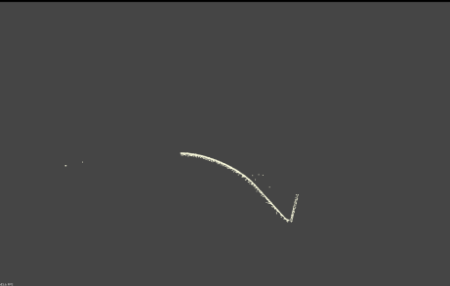


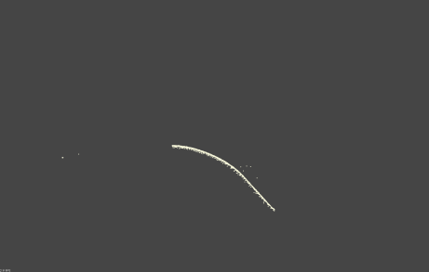
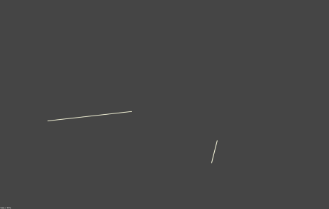
Perception
Line RANSAC
Next Iteration
Minus Inliers
Line Model,
Inliers
Projected Inliers
Filter points in cylinder
Extract and Store
End Points
Radius

Slide 14

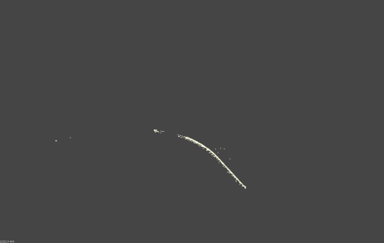
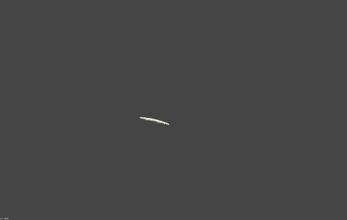
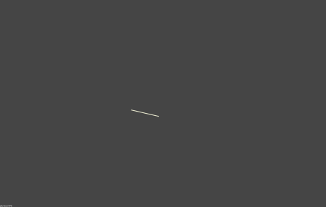

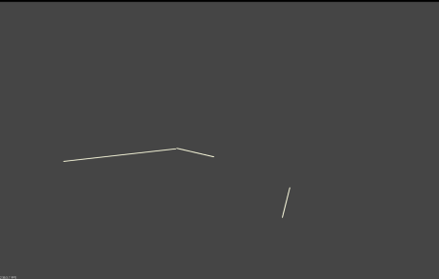
Perception
Line RANSAC
Next Iteration
Minus Inliers
Line Model,
Inliers
Projected Inliers
Filter points in cylinder
Extract and Store
End Points
Radius

Slide 15
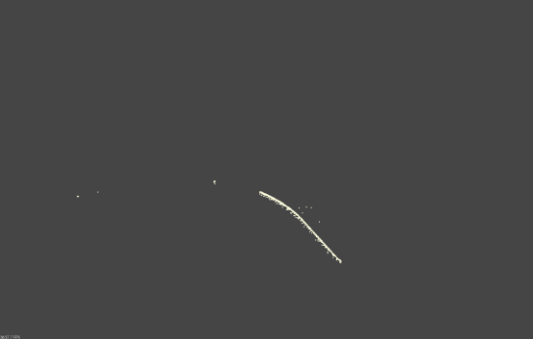
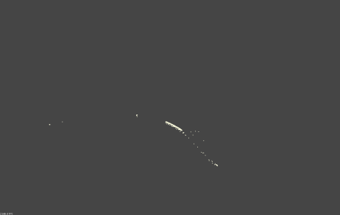
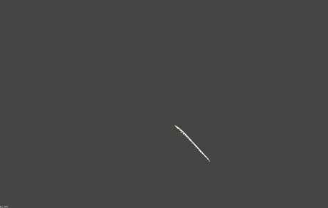
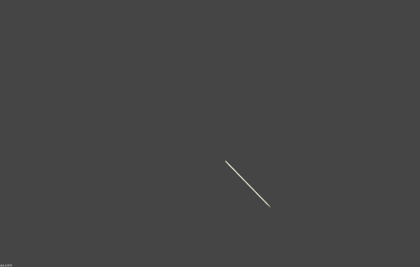
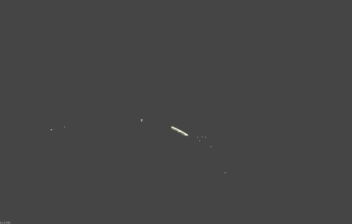
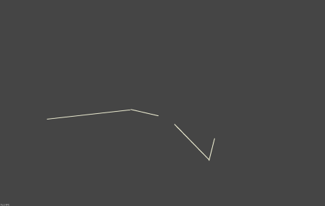
Perception
Line RANSAC
Next Iteration
Minus Inliers
Line Model,
Inliers
Projected Inliers
Filter points in cylinder
Extract and Store
End Points
Radius

Slide 16
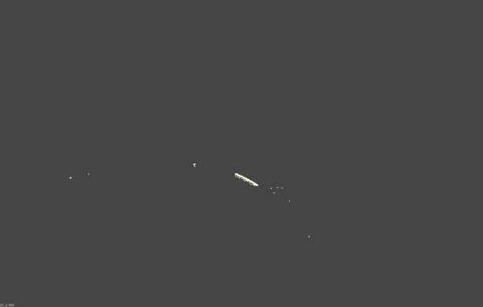
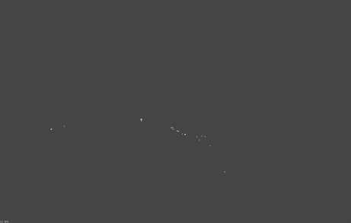
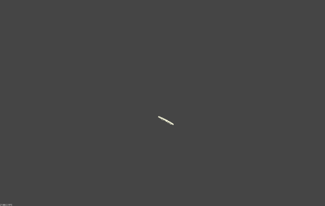

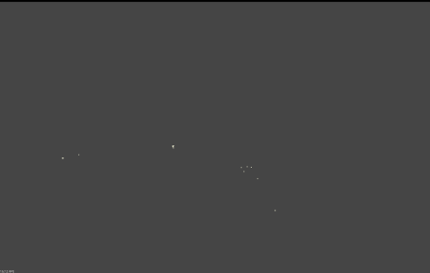
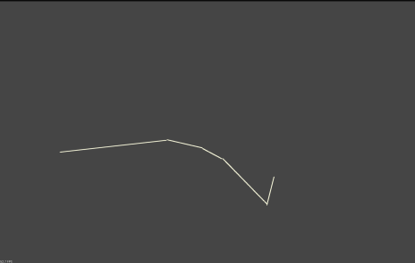
Perception
Line RANSAC
Next Iteration
Minus Inliers
Line Model,
Inliers
Projected Inliers
Filter points in cylinder
Extract and Store
End Points
Radius

Slide 17













Perception
Pose Representation
$${}_{t}^{i}T= {}_{w}^{1}{T^{−1}} ∗ {}_{w}^{i}T$$
i = 1,2...n
n = Number of Cylinders
$${}_{t}^{5}T$$
${}_{t}^{1}T$ = Identity
$${}_{t}^{3}T$$
$${}_{w}^{3}T$$
$${}_{w}^{5}T$$
$${}_{t}^{4}T$$
$${}_{w}^{4}T$$
$${}_{w}^{1}T$$
$${}_{t}^{2}T$$
$${}_{w}^{t}T$$
$${}_{w}^{2}T$$
World Frame
World Frame

Slide 18






Perception
Tube Model Approximation
Segmented
Point Cloud Cluster
$${}_{t}^{5}T$$
$${}_{t}^{3}T$$
Approximated
Tube Model
$${}_{t}^{4}T$$
Point Cloud
Processing
$${}_{t}^{2}T$$
$${}_{w}^{t}T$$
World Frame
+
Work Point Clusters

Slide 19





Grasp Analysis
Grasp Locations
$${}_{t}^{3}T$$
$${}_{t}^{5}T$$
Grasp Pair (Left & Right)
Joint Trajectory of both arms
Approximated
Tube Model
$${}_{t}^{4}T$$
$${}_{t}^{2}T$$
$${}_{w}^{t}T$$
GraspAnalysis
World Frame
+
Work Point Cluster
Grasp generation
Work Point Normal cluster to Work poses
Object Trajectory
Ik Solution & Collision Checking for Trajectory
Selected Grasp Pair based on Metrics

Slide 20
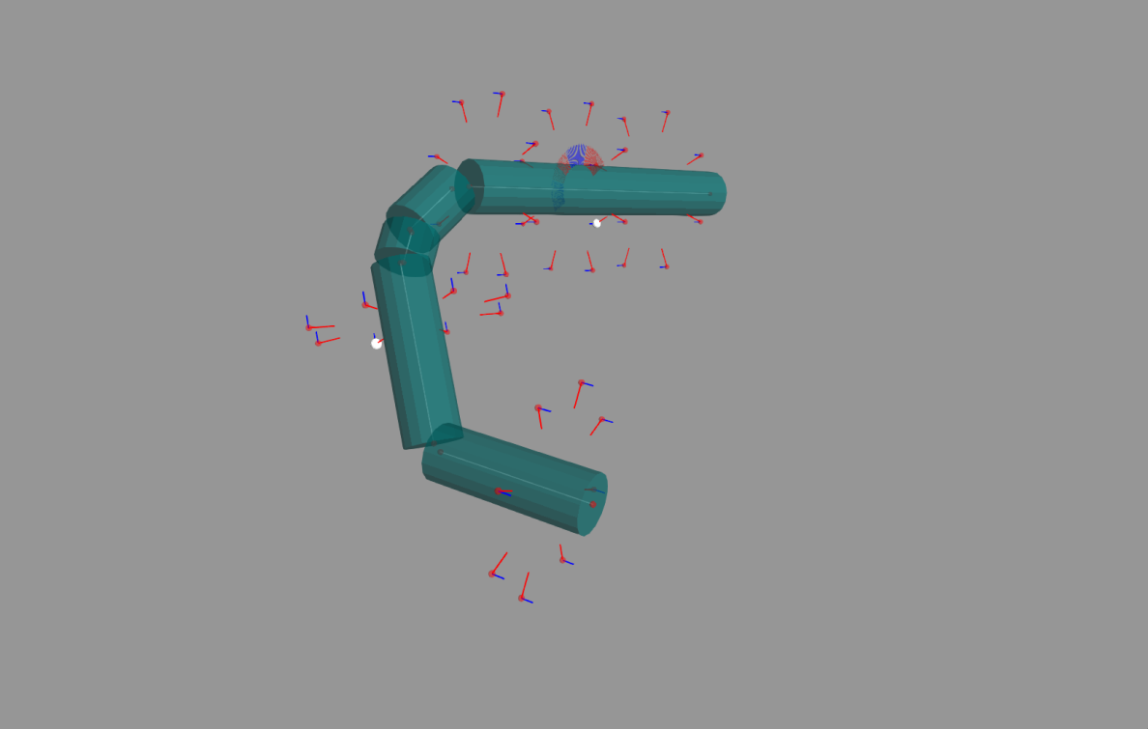
Grasp Analysis
Grasps
Grasp generation
Convert Work Points in to Contact Poses
Contact Pose
Image Sources :
http://en.wikipedia.org/wiki/Grinding_machine
http://www.smithy.com/machining-handbook/chapter-8/page/3

Slide 21
Grasp Analysis
Grasps
Grasp generation
Convert Work Points in to Contact Poses
Image Sources :
http://en.wikipedia.org/wiki/Grinding_machine
http://www.smithy.com/machining-handbook/chapter-8/page/3

Slide 22




Grasp Analysis
Grasps
Contact Poses to Tube Trajectory
Grasps
$${}_{t}^{p}T$$
$${}_{w}^{t}T$$
+
IK Solutions and Validity testing
$${}_{w}^{wp}T$$
Validated Grasp Pairs and Joint Trajectories for Both Arms
Store trajectory if valid
Rank Valid Trajectories
Select Grasp Pair with Highest Rank

Slide 23
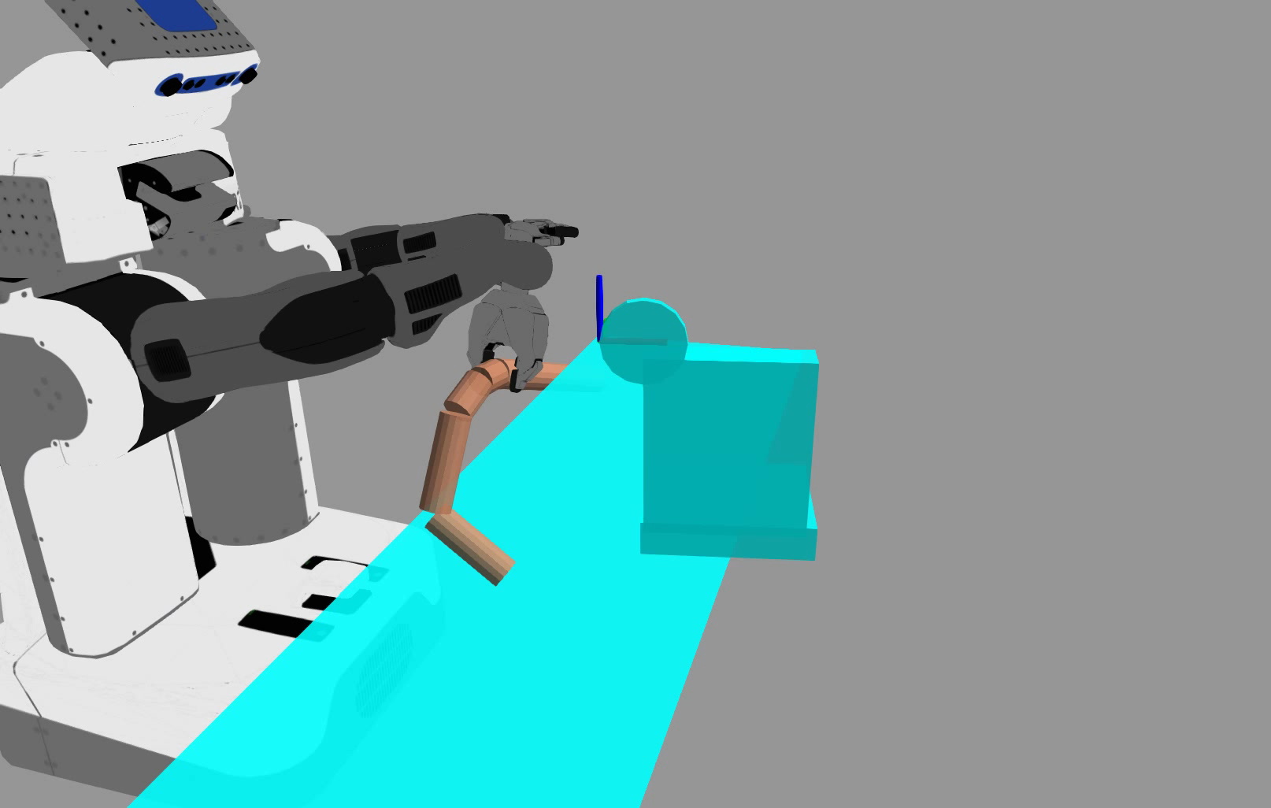
Grasp Analysis

Slide 24





Grasp Analysis
Ranking Using Manipulation Matric
Intersecting Length
Reactive Force Direction
$$\dot{x}=J(θ)\dot{θ}$$
$$JJ^{T}v=ʎv$$
$$τ=J^{T}ℱ$$
Force Ellipsoid
$$ℱ=J^{−T}τ$$
$${(JJ^{T})}^{−1}v=ʎ^{′}v$$
Notes:
Jacob is mapping between joint space and cart space
Unit circle -> ellipsoid and axis and length are represented as eigenvector and eigenvalues.

Slide 25
System Layout
Software Components
Environment
ManipulationMatrics
GraspAnalysis
ArmMnipulation
CloudProcessing
StateMachine
TubeModel
CollisionObjects
PCL Libraries
ROS Services

Slide 26
Process Flow

Slide 27
Results

Slide 28
Summary

Slide 29
Future Work
Improved Model Approximation
Color Processing
Optimized Grasp Analysis
Constrained Dual Arm Manipulation
Include Force Feedback

Slide 30
Reference
Martin A. Fischler and Robert C. Bolles. 1981. Random sample consensus: a paradigm for model fitting with applications to image analysis and automated cartography. Commun. ACM 24, 6 (June 1981), 381-395. DOI=10.1145/358669.358692 http://doi.acm.org/10.1145/358669.35869
Manipulability of closed kinematic chains FC Park, JW Kim Journal of mechanical design 120 (4), 542-548

Slide 31
Questions?

